Slide 1
CSE477
VLSI Digital Circuits
Fall 2002
Lecture 18: Dynamic Sequential Circuits
Mary Jane Irwin ( www.cse.psu.edu/~mji ) www.cse.psu.edu/~cg477
[Adapted from Rabaey’s Digital Integrated Circuits, ©2002, J. Rabaey et al.]

Slide 2
Review: Sequential Definitions
Static versus dynamic storage
  static uses a bistable element with feedback (regeneration) and thus preserves its state as long as the power is on
  static is preferred when updates are infrequent (clock gating)
  dynamic stores state on parasitic capacitors so only holds the state for a period of time (milliseconds) and requires periodic refresh
  dynamic is usually simpler (fewer transistors), higher speed, lower power
Latch versus flipflop
  latches are level sensitive with two modes: transparent - inputs are passed to Q and hold - output stable
  fliplflops are edge sensitive that only sample the inputs on a clock transition
Notes:
Dynamic storage requires periodic refresh of the value.
Reading the value of the stored signal from a capacitor without disrupting the charge requires the availability of a device with a high input impedance

Slide 3
Review: Timing Metrics
In
D
Q
Out
clock
clock
t_{su}
t_{hold}
time
In
data
stable
t_{c-q}
time
Out
output
stable
output
stable
time
Notes:
tsetup – time that the data inputs (D) must be valid before the clock transition (0 ti 1 transition for a positive edge-triggered device)
thold is the time that the data inputs must remain valid after the clock edge
Tc-q is the worst case propagation delay (with reference to the clock edge) – time to copy D to Q

Slide 4
Review: System Timing Constraints
Inputs
Outputs
Combinational
Logic
Current
State
Next
State
State
Registers
T (clock period)
clock
t_{cdreg} + t_{cdlogic} ≥ t_{hold}
T ≥ t_{c-q} + t_{plogic} + t_{su}
Notes:
contamination delay - minimum delay of the combinational logic or register
Thus, it is important to minimize the values of the timing parameters associated with the register. In modern high-performance systems, the register propagation delay and set-up times account for a significant portion of the clock period. E.g., DEC Alpha EV6 has a maximum logic depth of 12 gates and the register overhead accounts for about 15% of the clock period.
Hold time becomes and issue then there is little logic between registers or when the clocks at different registers are somewhat out of phase due to clock skew.
Modern machines are characterized by a very-low logic depth and, in fact, the register propagation delay and setup times account for a significant portion of the clock period. E.g., DEC EV6 has a maximum logic depth of 12 gates and the register overhead accounts for approx. 15% of the clock period.

Slide 5
You spend all this time designing one machine and it’s only a hot box for two years, and it has all the useful life of a washing machine.
The Soul of a New Machine, Kidder, pg. 239

Slide 6
Dynamic ET Flipflop
master
slave
!clk
clk
Q_{M}
D
T₁
I₁
T₂
I₂
Q
C₁
C₂
clk
!clk
t_{su} =
t_{hold} =
t_{c-q} =
clk
!clk
Notes:
For class handout

Slide 7
Dynamic ET Flipflop
master
slave
!clk
clk
Q_{M}
D
T₁
I₁
T₂
I₂
Q
C₁
C₂
clk
!clk
t_{su} =
t_{hold} =
t_{c-q} =
t_{pd_tx}
zero
master transparent
slave hold
2 t_{pd_inv} + t_{pd_tx}
clk
!clk
master hold
slave transparent
Notes:
C1 is the gate cap of I1, the junction cap of T1 and the overlap gate cap of T1
8 transistors, so very efficient
tsetup is delay of the transmission gate (time it takes C1 to sample D input)
hold time is zero since T1 is turned off on the clock edge so further input changes are ignored
tpFF is two inverter delays plus the delay of T2
Remember – dynamic nodes (C1 and C2) only hold their state so long, so ff has to be refreshed periodically to prevent state loss due to charge leakage

Slide 8
Dynamic ET FF Race Conditions
!clk
clk
Q_{M}
D
T₁
I₁
T₂
I₂
Q
C₁
C₂
clk
!clk
0-0 overlap race condition
t_{overlap0-0} < t_{T1} +t_{I1} + t_{T2}
clk
!clk
1-1 overlap race condition
t_{overlap1-1} < t_{hold}
Notes:
clock overlap leads to race conditions
1-1 race fixed by enforcing a hold time - data must be stable during the high-high overlap period
0-0 race fixed by making sure there is enough delay between D and C2 so that new data sampled by the master does not propagate to the slave (can be ensured by enforcing appropriate setup time)

Slide 9
Dynamic Two-Phase ET FF
clk1
clk2
Q_{M}
D
T₁
I₁
T₂
I₂
Q
C₁
C₂
!clk1
!clk2
master transparent
slave hold
clk1
t_{non_overlap}
clk2
master hold
slave transparent
Notes:
Keep clock nonoverlap time large enough that no overlap occurs even in the presence of clock skew
But now have 4 clock signals to route!

Slide 10
Pseudostatic Dynamic Latch
Robustness considerations limit the use of dynamic FF’s
  coupling between signal nets and internal storage nodes can inject significant noise and destroy the FF state
  leakage currents cause state to leak away with time
  internal dynamic nodes don’t track fluctuations in V_{DD} that reduces noise margins
A simple fix is to make the circuit pseudostatic
!clk
D
clk
Add above logic added to all dynamic latches
Notes:
adding a weak feedback inverter to each latch
comes at a slight cost in delay (adds to the capacitive load) and power consumption, but it improves noise immunity significantly

Slide 11
C²MOS (Clocked CMOS) ET Flipflop
A clock-skew insensitive FF
Master
Slave
M₂
M₆
clk
M₄
!clk
M₈
Q_{M}
D
Q
!clk
M₃
C₁
clk
M₇
C₂
M₁
M₅
clk
!clk
Notes:
For class handout

Slide 12
C²MOS (Clocked CMOS) ET Flipflop
A clock-skew insensitive FF
Master
Slave
M₂
M₆
clk
on
!clk
off
M₄
M₈
off
Q_{M}
on
D
Q
!clk
on
C₁
clk
off
C₂
M₃
M₇
off
on
M₁
M₅
master transparent
slave hold
clk
!clk
master hold
slave transparent
Notes:
For lecture
Positive edge-triggered MS flipflop, just like the one two slides ago (and again only 8 transistors and 4 clock loads), however with one important difference
A C2MOS flipflp with clk and !clk clocking is insensitive to clock overlap as long as the rise and fall times of the clock edges are sufficiently small

Slide 13
C²MOS FF 0-0 Overlap Case
Clock-skew insensitive as long as the rise and fall times of the clock edges are sufficiently small
M₂
M₆
0
M₄
0
M₈
Q_{M}
D
Q
C₁
C₂
M₁
M₅
clk
clk
!clk
!clk
Notes:
Does any new data sampled during the overlap window propagate to Q (race)?
New data is sampled on QM, but cannot propagate to Q since M7 is off (slave is in hold). Any new data sampled on the falling clock edge is not seen at Q
For clocking on left – at the end of the overlap period !clk = 1 and both M7 and M8 turn off, putting the slave stage in the hold mode
For the clocking on the right – at the end of the overlap period clk = 1 and both M3 and M4 turn off, putting the master in the hold mode (affects setup time as well)
Means that the FF is slower (slower tc-q time)

Slide 14
C²MOS FF 1-1 Overlap Case
M₂
M₆
Q_{M}
D
Q
1
M₃
C₁
1
M₇
C₂
M₁
M₅
clk
clk
!clk
!clk
1-1 overlap constraint
t_{overlap1-1} < t_{hold}
Notes:
Does any new data sampled during the overlap window (right after the clock goes high) propagate to Q (race)?
New data is sampled on QM, but cannot propagate to Q since M8 is off (slave is in hold). Any new data sampled on the falling clock edge is not seen at Q
A bit more problematic than 0-0 overlap. Must enforce a hold time on D, so that D changing that makes it to QM is not copied to Q when overlap time is over (and !clk goes to zero turning on M8) - first clocking condition. By imposing a hold time on D - that D must be stable during clock overlap - overcome this problem as well
However, if the rise/fall times of the clock are sufficiently slow, have possible race. Works correctly as long as the clock rise/fall times is smaller than approximately five times the propagation delay of the flipflop.

Slide 15
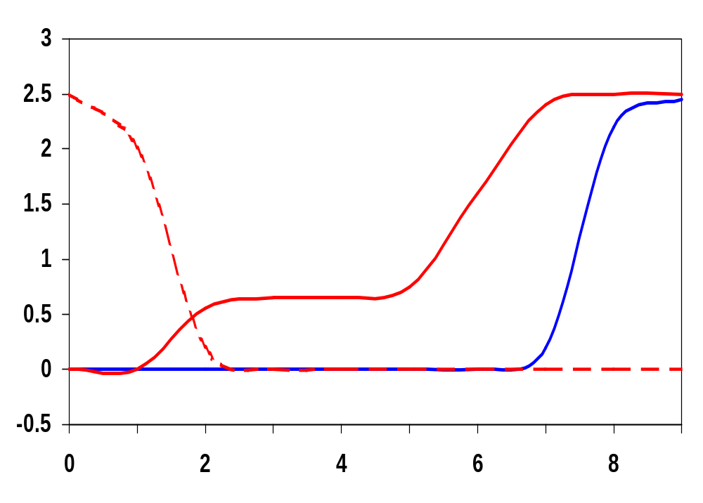
C²MOS Transient Response
For a
0.1 ns clock
Q_{M}(3)
Q(3)
Volts
Q(0.1)
clk(0.1)
For a
3 ns clock
(race condition
exists)
clk(3)
Time (nsec)
Notes:
For slow clocks, potential for a race condition exists

Slide 16
Pipelining using C²MOS
M₂
M₆
M₂
clk
M₄
!clk
M₈
clk
M₄
F
G
Out
In
!clk
M₃
C₁
clk
M₇
C₂
!clk
M₃
C₃
M₁
M₅
M₁
NORA Logic
What are the constraints on F and G?
Notes:
Positive edge-triggered MS flipflop, just like the one two slides ago (and again only 8 transistors), however with one important difference
A C2MOS flipflp with clk and !clk clocking is insensitive to clock overlap as long as the rise and fall times of the clock edges are sufficiently small

Slide 17
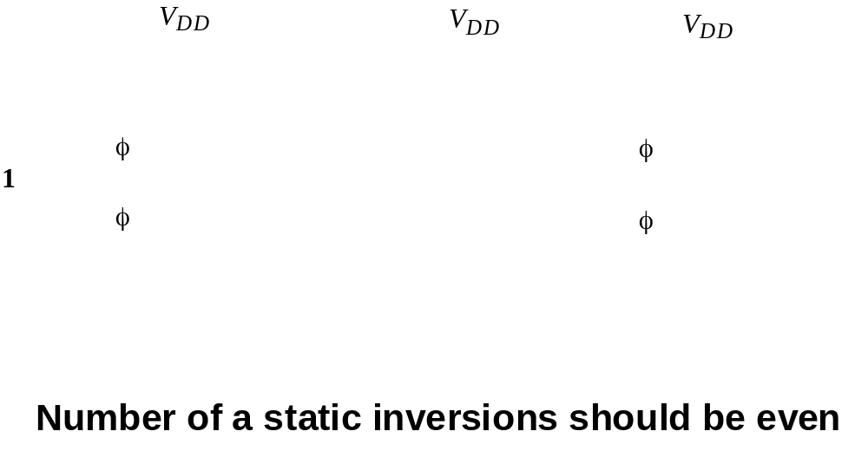
Example
Notes:
Need to redo

Slide 18
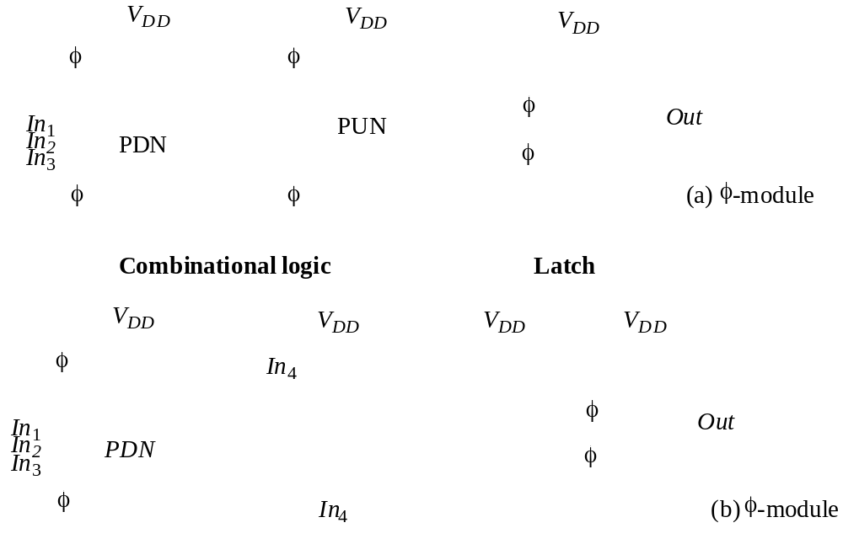
NORA CMOS Modules
Notes:
Need to redo

Slide 19
True Single Phase Clocked (TSPC) Latches
Negative Latch
Positive Latch
clk
clk
Q
In
In
clk
clk
Q
hold when clk = 1
transparent when clk = 0
transparent when clk = 1
hold when clk = 0
Notes:
Uses only a single clock – so no clock overlap (skew) to worry about; also reduced clock load
Transparent mode is equivalent to two cascaded inverters (latch is non-inverting)

Slide 20
Embedding Logic in TSPC Latch
PUN
A
B
Q
Q
In
clk
clk
clk
clk
A
PDN
B
Notes:
Can embed logic into latch (or ff) - reduces the delay overhead associated with the latch.
Set-up time increased, but overall performance improved: the increase in the set-up time is typically smaller than the delay of an AND gate. E.g., using minimum size devices set-up of AND latch is 140 psec. Using the conventional approach of AND gate followed by latch has an effective set-up time of 600 psec.
Technique used extensively in the design of the EV4 DEC Alpha microprocessor and many other high performance processors.

Slide 21
TSPC ET FF
Master
Slave
clk
clk
Q
D
Q_{M}
clk
clk
clk
Notes:
For class handout

Slide 22
TSPC ET FF
Master
Slave
on
on
on
clk
clk
on
on
on
Q
D
Q_{M}
off
off
clk
clk
off
off
off
off
master transparent
slave hold
master hold
slave transparent
clk
Notes:
For lecture
Clock load of 4 transistors (similar to transmission gate or C2MOS) but only one clock to drive and route (12 transistors as compared to 8 in the previous two designs)
Virtually all constraints removed - no clocks to overlap, no race
Warning - similar to C2MOS, TSPC malfunctions when the slope of the clock is not sufficiently steep. Slow clock cause both the NMOS and PMOS clocked transistors to be on simultaneously, resulting in undefined values of the states and race conditions. Clock slopes thus must be carefully engineered. If necessary, local buffers must be introduced to ensure the quality of the clock signal.

Slide 23
Simplified TSPC ET FF
M₃
clk
M₆
M₉
Q_{M}
Q
D
clk
M₂
X
clk
M₅
M₈
M₁
clk
M₄
M₇
clk
Notes:
For class handout

Slide 24
Simplified TSPC ET FF
off
M₃
clk
on
M₆
M₉
Q_{M}
→ 1
→ D
Q
→ D
D
clk
on
M₂
X
off
→ !D
clk
off
M₅
on
M₈
M₁
clk
off
M₄
M₇
on
master transparent
slave hold
master hold
slave transparent
clk
Notes:
Positive edge triggered - ask class why! Still clock load of 4 transistors (similar to transmission gate or C2MOS) but only one clock to drive and route, and now only 9 (or 11 if really need Q not !Q) transistors (as compared to 8 in previous two)
When clk=0, the input inverter is sampling D onto X, the second (dynamic inverter) is in the precharge mode so Y is 1, and the third inverter is in hold mode (so Q is stable).
On the rising edge of the clock, the middle inverter evaluates and since the third inverter is sampling when clk=1 the output Q goes to its new state.
On the positive edge of the clock, note that the node X transitions to a low if D is high. Therefore, the input must be kept stable until the value on node X before the rising edge of the clock propagates to Y – hold time of the register (less than 1 inverter delay since it takes 1 inverter delay for the input to affect node X).
Propagation delay is essentially three inverters since the value on node X must propagate to output Q
Set-up time is the time for node X to be valid – one inverter delay

Slide 25
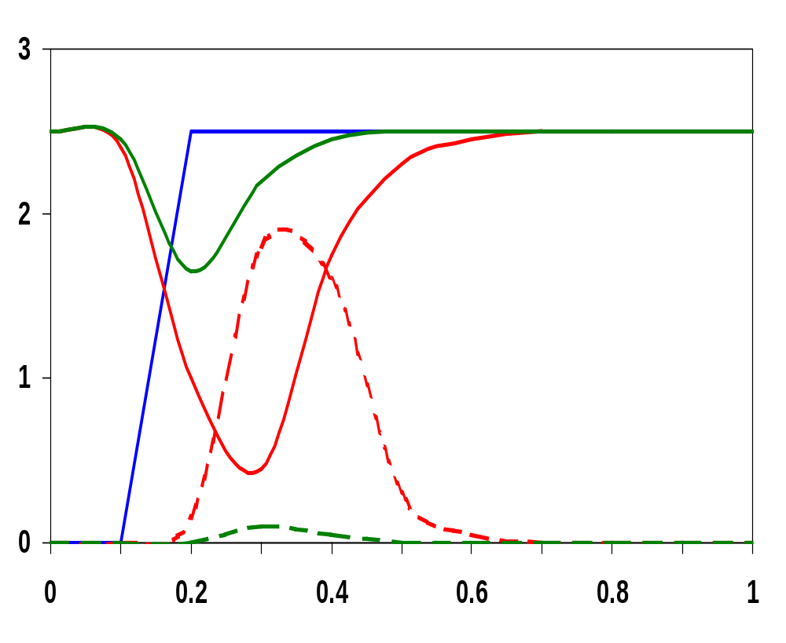
Sizing Issues in Simplified TSPC ET FF
clk
!Q_{mod}
Transistor sizing
Original width
M₄, M₅ = 0.5μm
M₇, M₈ = 2μm
Modified width
M₄, M₅ = 1μm
M₇, M₈ = 1μm
!Q_{orig}
Volts
Q_{orig}
Q_{mod}
Time (nsec)
Notes:
Sizing is critical – with improper sizing glitches may occur due to race condition when the clock transitions from low to high. When clk transitions from low to high, nodes Y and !Q start to discharge simultaneously (case for D low). Once Y is sufficiently low, the trend on !Q reverses. Note glitch (red case) and also reduces contamination delay. Can fix by resizing (note green case) so that the relative strengths of the pull-down paths of the second and third inverter let Y discharge faster than !Q

Slide 26
Split-Output TSPC Latches
Positive Latch
Negative Latch
Q
A
In
clk
In
clk
A
Q
transparent when clk = 1
hold when clk = 0
hold when clk = 1
transparent when clk = 0
When In = 0, A = V_{DD} - V_{Tn}
When In = 1, A = | V_{Tp} |
Notes:
Also called split-output latches - reduces clock load by half (to two for a ff composed of a positive-negative latch pair).
Downside is not all node voltages in the latch experience full logic swing due to threshold drop. E.g., for positive latch when D=0 and clk=1, A=Vdd-Vth (Also limits the amount of Vdd scaling possible with this latch).

Slide 27
Split-Output TSPC ET FF
clk
D
clk
Q_{M}
Q
clk
Notes:
Which edge-triggered?
Now clock load of only 2 transistors and 8+2 transistors

Slide 28
Pulsed FF (AMD-K6)
Pulse registers - a short pulse (glitch clock) is generated locally from the rising (or falling) edge of the system clock and is used as the clock input to the flipflop
  race conditions are avoided by keeping the transparent mode time very short (during the pulse only)
  advantage is reduced clock load; disadvantage is substantial increase in verification complexity
0/Vdd
ON/OFF
OFF
clk
0
1
P₁
ON
P₃
X
Vdd
Q
1/0
M₃
OFF
M₆
OFF
ON
ON
D
1/0
M₂
ON/
OFF
P₂
M₅
1
1
0
1
ON
M₁
!clkd
M₄
ON
0
OFF
Notes:
When the clock is low, M3 and M6 are off, and P1 is on precharging node X. And the output node Q is decoupled from X so is in hold mode.
!clkd is a delayed inverted version of clk. On the rising edge of clk, M3 and M6 turn on while M1 and M4 stay on for a short period. During this period the ff is transparent and the input data D is sampled by the ff. Once !clkd goes low, node X is decoupled from the input and is either held or starts to precharge to Vdd by PMOS device P2.
On the falling edge of the clock, node X is held at Vdd and the output is held stable by the cross-coupled inverters.
Note that the one-shot (pulse) is integrated into the register. The transparency period determines the hold time. The window must be wide enough for the input data to propagate to Q. Note also that the set-up time can be NEGATIVE (if the transparency window is longer than the delay from input to output). This is attractive, as data can arrive at the register even after the clock goes high, meaning that time can be borrowed from the previous cycle.

Slide 29
Sense Amp FF (StrongArm SA100)
Sense amplifier (circuits that accept small swing input signals and amplify them to full rail-to-rail signals) flipflops
  advantages are reduced clock load and that it can be used as a receiver for reduced swing differential buses
0
1
D
1
M₉
M₂
1
0
M₅
M₇
Q
M₁
M₄
1
!Q
M₆
M₈
M₃
1
1
0
M₁₀
clk
0
1
Notes:
Sense amplifier based

Slide 30
Flipflop Comparison Chart
Name | Type | #clk ld | #tr | t_{set-up} | t_{hold} | t_{pFF}
Mux | Static | 8 (clk-!clk) | 20 | 3t_{pinv}+t_{ptx} | 0 | t_{pinv}+t_{ptx}
PowerPC | Static | 8 (clk-!clk) | 16
2-phase | Ps-Static | 8 (clk1-clk2) | 16
T-gate | Dynamic | 4 (clk-!clk) | 8 | t_{ptx} | t_{o1-1} | 2t_{pinv}+t_{ptx}
C²MOS | Dynamic | 4 (clk-!clk) | 8
TSPC | Dynamic | 4 (clk) | 11 | t_{pinv} | t_{pinv} | 3t_{pinv}
S-O TSPC | Dynamic | 2 (clk) | 10
AMD K6 | Dynamic | 5 (clk) | 19
SA 100 | SenseAmp | 3 (clk) | 20

Slide 31
Choosing a Clocking Strategy
Choosing the right clocking scheme affects the functionality, speed, and power of a circuit
Two-phase designs
  + robust and conceptually simple
  - need to generate and route two clock signals
  - have to design to accommodate possible skew between the two clock signals
Single phase designs
  + only need to generate and route one clock signal
  + supported by most automated design methodologies
  + don’t have to worry about skew between the two clocks
  - have to have guaranteed slopes on the clock edges

Slide 32
Next Lecture and Reminders
Next lecture
  Timing issues, Intro to datapath design
    Reading assignment – Rabaey, et al, 10.1-10.3.3; 11.1-11.2
Reminders
  Pick up second half of the new edition of the book from Sue in 202 Pond Lab
  Project final reports due December 5th
  HW4 due November 5th
  HW5 out November 5th and due November 19th
  Final exam scheduled
    Monday, December 16th from 10:10 to noon in TBD

